Slide 1
Covectors
Part 1: What’s a covector?

Slide 2

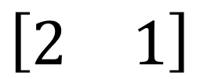



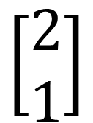
Covectors are “basically” Row Vectors
$$\left[\begin{matrix}2 \\ 1\end{matrix}\right]$$
Tada!
$$\left[\begin{matrix}2 & 1\end{matrix}\right]$$
$$\vec{e_{2}}$$
This is not quite right…
It’s true in an orthonormal basis.
$$\vec{e_{1}}$$
$$\tilde{\vec{e_{1}}}$$
It’s not true in general
$$\tilde{\vec{e_{2}}}$$

Slide 3
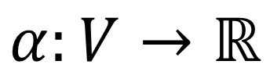
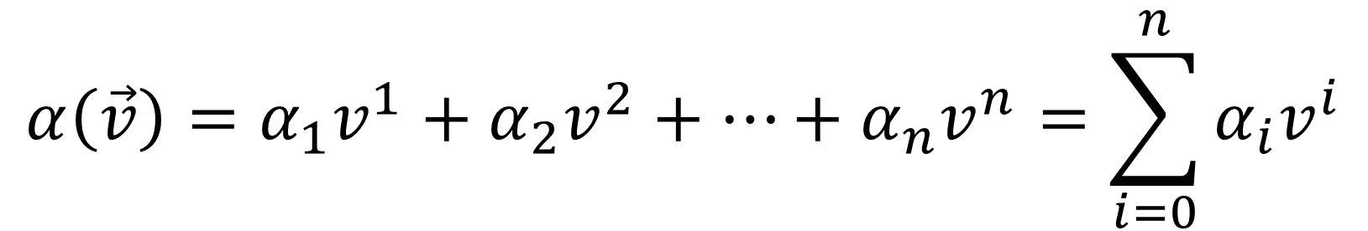
Row vectors are functions on (column) vectors
$$\left[\begin{matrix}2 & 1\end{matrix}\right]\left(\left[\begin{matrix}3 \\ −4\end{matrix}\right]\right)=\left(2\right)\left(3\right)+\left(1\right)\left(−4\right)=6−4=2$$
$$α\left(\vec{v}\right)=α_{1}v^{1}+α_{2}v^{2}+…+α_{n}v^{n}=\sum_{i=0}^{n}{α_{i}v^{i}}$$
$$α:V→ℝ$$

Slide 4
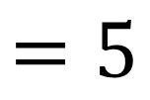
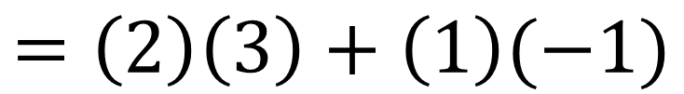
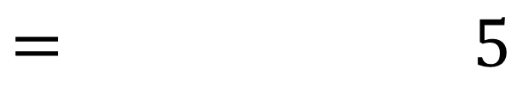
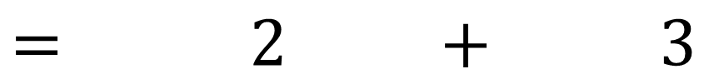
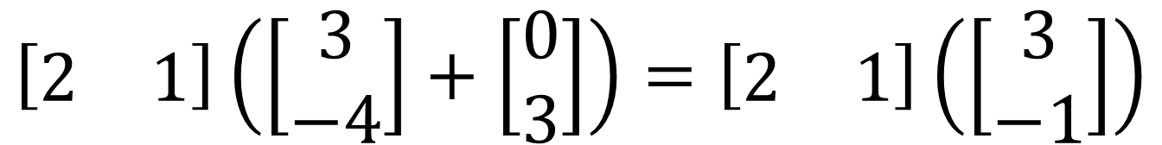
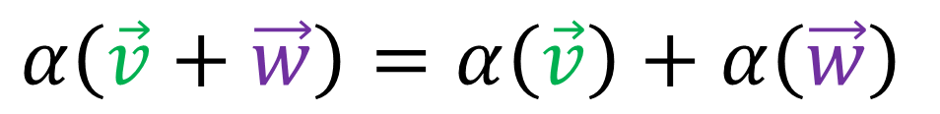
$$\left[\begin{matrix}2 & 1\end{matrix}\right]\left(\left[\begin{matrix}3 \\ −4\end{matrix}\right]+\left[\begin{matrix}0 \\ 3\end{matrix}\right]\right)=\left[\begin{matrix}2 & 1\end{matrix}\right]\left[\begin{matrix}3 \\ −4\end{matrix}\right]+\left[\begin{matrix}2 & 1\end{matrix}\right]\left[\begin{matrix}0 \\ 3\end{matrix}\right]$$
$$= 2 + 3$$
$$= 5$$
$$\left[\begin{matrix}2 & 1\end{matrix}\right]\left(\left[\begin{matrix}3 \\ −4\end{matrix}\right]+\left[\begin{matrix}0 \\ 3\end{matrix}\right]\right)=\left[\begin{matrix}2 & 1\end{matrix}\right]\left(\left[\begin{matrix}3 \\ −1\end{matrix}\right]\right)$$
$$=\left(2\right)\left(3\right)+\left(1\right)(−1)$$
$$=5$$
$$α\left(\vec{v}+\vec{w}\right)=α\left(\vec{v}\right)+α\left(\vec{w}\right)$$

Slide 5
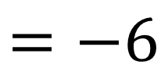
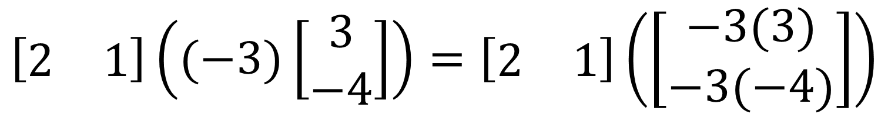
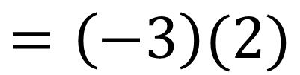
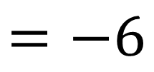
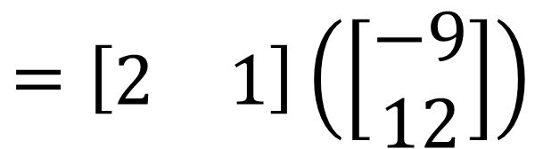
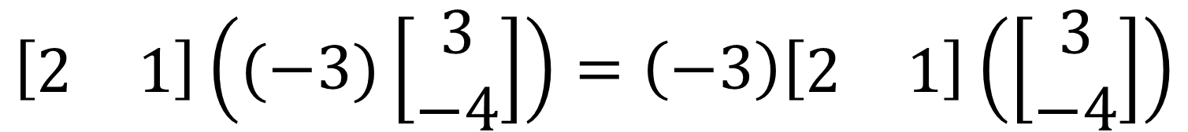
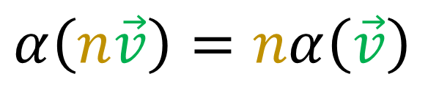
$$\left[\begin{matrix}2 & 1\end{matrix}\right]\left((−3)\left[\begin{matrix}3 \\ −4\end{matrix}\right]\right)=\left[\begin{matrix}2 & 1\end{matrix}\right]\left(\left[\begin{matrix}−3(3) \\ −3(−4)\end{matrix}\right]\right)$$
$$=\left[\begin{matrix}2 & 1\end{matrix}\right]\left(\left[\begin{matrix}−9 \\ 12\end{matrix}\right]\right)$$
$$=−6$$
$$\left[\begin{matrix}2 & 1\end{matrix}\right]\left((−3)\left[\begin{matrix}3 \\ −4\end{matrix}\right]\right)=\left(−3\right)\left[\begin{matrix}2 & 1\end{matrix}\right]\left(\left[\begin{matrix}3 \\ −4\end{matrix}\right]\right)$$
$$=\left(−3\right)(2)$$
$$=−6$$
$$α\left(n\vec{v}\right)=nα\left(\vec{v}\right)$$

Slide 6
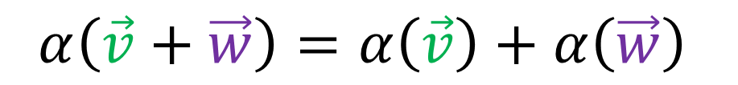
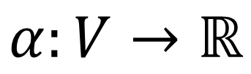
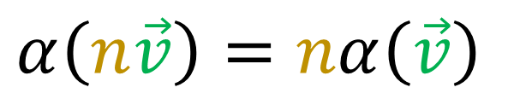
A covector (row vector) is…
A function that takes a vector and produces a scalar/number
We can add inputs or add output and get the same answer
We can scale inputs or scale outputs and get the same answer
$$α:V→ℝ$$
$$α\left(\vec{v}+\vec{w}\right)=α\left(\vec{v}\right)+α\left(\vec{w}\right)$$
$$α\left(n\vec{v}\right)=nα\left(\vec{v}\right)$$
$$α\left(n\vec{v}+m\vec{w}\right)=nα\left(\vec{v}\right)+mα\left(\vec{w}\right)$$

Slide 7


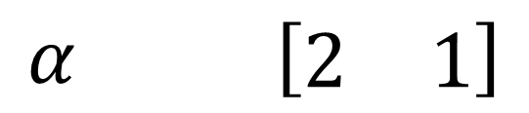
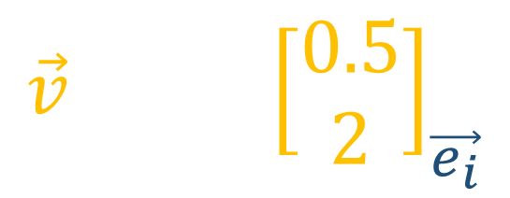



How do we visualize covectors (row vectors)?
$$\vec{v}$$
$$\vec{v} {\left[\begin{matrix}0.5 \\ 2\end{matrix}\right]}_{\vec{e_{i}}}$$
$$\vec{e_{2}}$$
$$α$$
$$α \left[\begin{matrix}2 & 1\end{matrix}\right]$$
$$\vec{e_{1}}$$

Slide 8
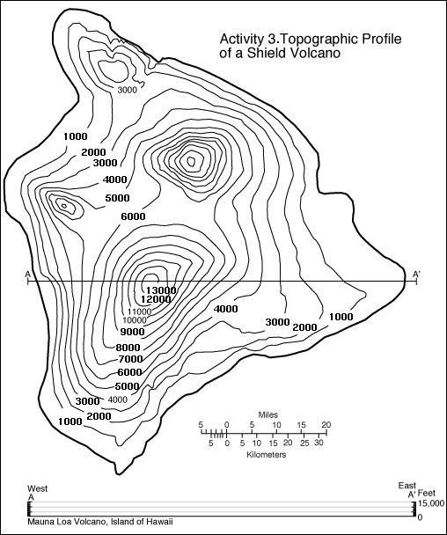
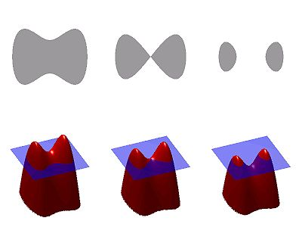
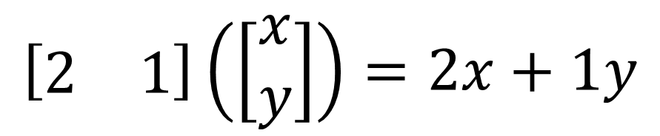
How do we visualize covectors (which are functions)?
$$\left[\begin{matrix}2 & 1\end{matrix}\right]\left(\left[\begin{matrix}x \\ y\end{matrix}\right]\right)=2x+1y$$

Slide 9


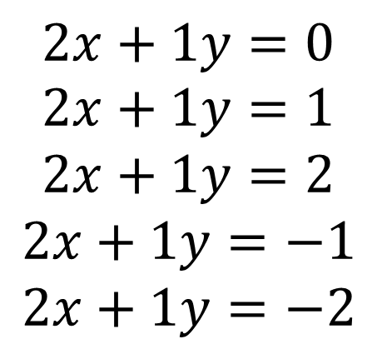
How do we visualize covectors (which are functions)?
$$\left[\begin{matrix}2 & 1\end{matrix}\right]\left(\left[\begin{matrix}x \\ y\end{matrix}\right]\right)=2x+1y$$
$$2x+1y=0$$
$$2x+1y=1$$
$$2x+1y=2$$
$$2x+1y=−1$$
$$2x+1y=−2$$
$$\vec{e_{2}}$$
$$\vec{e_{1}}$$

Slide 10







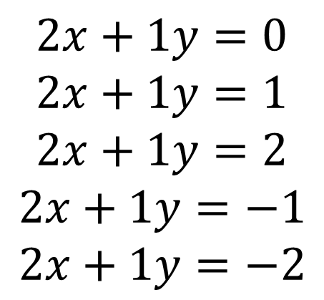


$$\left[\begin{matrix}2 & 1\end{matrix}\right]\left(\left[\begin{matrix}x \\ y\end{matrix}\right]\right)=2x+1y$$
$$2$$
$$3$$
$$4$$
$$5$$
$$1$$
$$0$$
$$−1$$
$$−2$$
$$\vec{e_{2}}$$
$$2x+1y=0 \\ 2x+1y=1$$
$$2x+1y=2$$
$$2x+1y=−1$$
$$2x+1y=−2$$
$$−3$$
$$\vec{e_{1}}$$

Slide 11

$$\left[\begin{matrix}2 & 1\end{matrix}\right]\left(\left[\begin{matrix}x \\ y\end{matrix}\right]\right)=2x+1y$$
$$2$$
$$3$$
$$4$$
$$5$$
$$1$$
$$0$$
$$−1$$
$$−2$$
$$\vec{e_{2}}$$
$$2x+1y=0 \\ 2x+1y=1$$
$$2x+1y=2$$
$$2x+1y=−1$$
$$2x+1y=−2$$
$$α$$
$$−3$$
$$\vec{e_{1}}$$

Slide 12

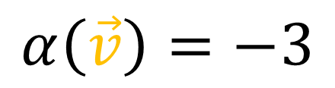


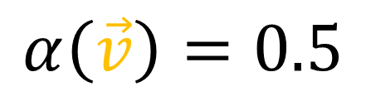

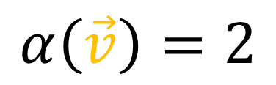




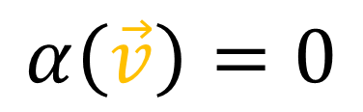
$$α$$
$$α$$
$$α$$
$$α$$
$$\vec{v}$$
$$\vec{v}$$
$$\vec{v}$$
$$\vec{v}$$
$$α\left(\vec{v}\right)=2$$
$$α\left(\vec{v}\right)=0.5$$
$$α\left(\vec{v}\right)=−3$$
$$α\left(\vec{v}\right)=0$$

Slide 13



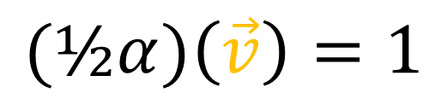
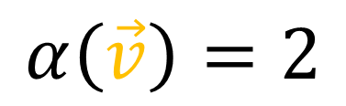




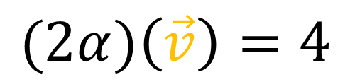

$$α$$
$$2α$$
$$\text{½}α$$
$$\vec{v}$$
$$\vec{v}$$
$$\vec{v}$$
$$α\left(\vec{v}\right)=2$$
$$(2α)\left(\vec{v}\right)=4$$
$$\text{(}\text{½}α)\left(\vec{v}\right)=1$$
$$(2α)\left(\vec{v}\right)=2α\left(\vec{v}\right)$$
$$(\text{½}α)\left(\vec{v}\right)=\text{½}α\left(\vec{v}\right)$$

Slide 14



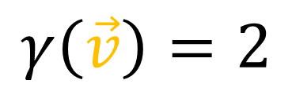

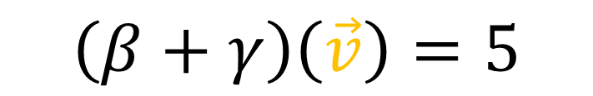


$$β+γ$$
$$β$$
$$\vec{v}$$
$$γ$$
$$β\left(\vec{v}\right)=3$$
$$γ\left(\vec{v}\right)=2$$
$$\left(β+γ\right)\left(\vec{v}\right)=5$$
$$\left(β+γ\right)\left(\vec{v}\right)=β\left(\vec{v}\right)+γ\left(\vec{v}\right)$$

Slide 15



Dual Vector Space $(V^{∗},S,+,⋅)$
Vector Space $(V,S,+,⋅)$
Elements of $V^{∗}$ are covectors, $V→ℝ$
$(n⋅α)\left(\vec{v}\right)=nα\left(\vec{v}\right)$
$\left(β+γ\right)\left(\vec{v}\right)=β\left(\vec{v}\right)+γ\left(\vec{v}\right)$

Slide 16
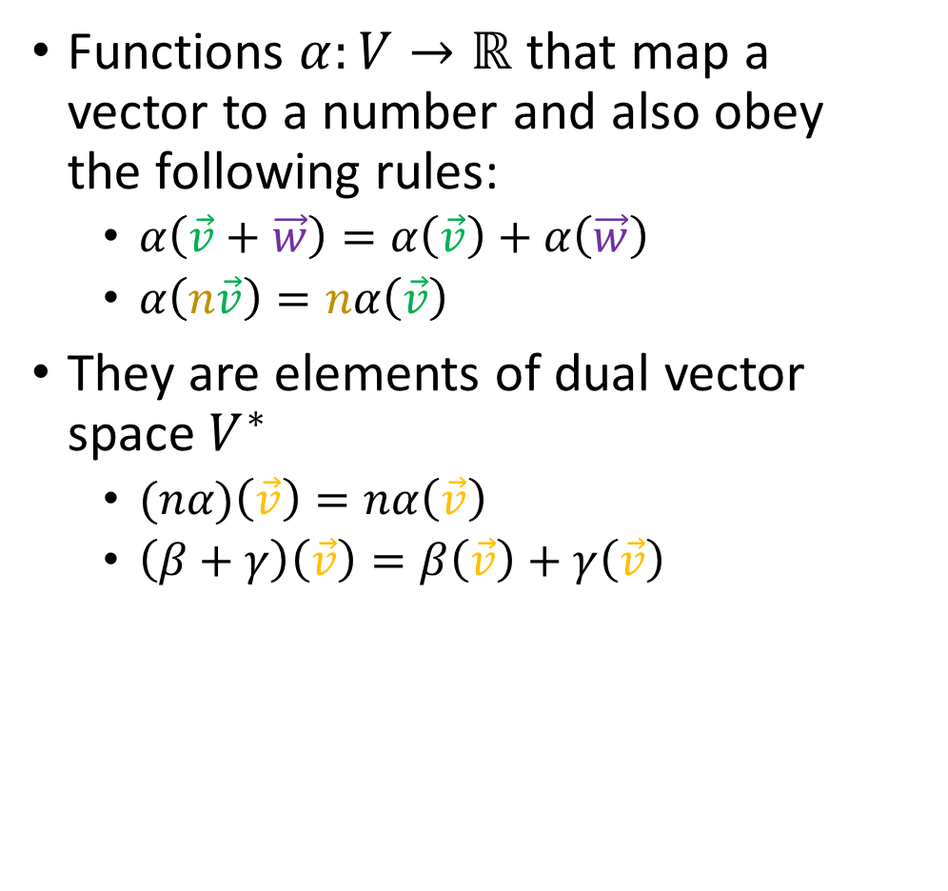


Covectors are…
Functions $α:V→ℝ$ that map a vector to a number and also obey the following rules:
$α\left(\vec{v}+\vec{w}\right)=α\left(\vec{v}\right)+α\left(\vec{w}\right)$
$α\left(n\vec{v}\right)=nα\left(\vec{v}\right)$
They are elements of dual vector space $V^{∗}$
$(nα)\left(\vec{v}\right)=nα\left(\vec{v}\right)$
$\left(β+γ\right)\left(\vec{v}\right)=β\left(\vec{v}\right)+γ\left(\vec{v}\right)$
We can visualize them as (oriented) stacks:
$$α$$
$$\vec{v}$$

